Slide 1
Review-2 on Web-Based Facial Authentication System
Mohammed Adnan 2010030236
Motupally Chaitanya 2010030366
Gande Saiteja 2010030055
Gilla Samanth 2010030272
Under the Guidance of
P. Sree Lakshmi
Associate Professor
Computer Science and Engineering Department
KL Hyderabad Off Campus, Aziz Nagar ,Hyderabad

Slide 2

Overview
Introduction
Objectives of the Project
Literature Review
Proposed Methodology/Architecture/Algorithm/Technique/etc
Implementation Details
Results/Outputs
References

Slide 3
Introduction
Provide an overview of the current state of online security and authentication challenges.
Mention the rise in cyber threats and the need for more secure authentication methods.
Introduce the concept of facial recognition technology as a solution.
A face recognition system is a technology that can identify and verify people from digital images and footage which is stored in their DB.
We decided to use the same face recognition approaches for web authentication for improving the security in websites and bringing a new approach in web authentication.

Slide 4
Objectives of the Project
Improve the security of the application by implementing facial authentication as a robust and reliable user verification method.
Provide a user-friendly login experience by enabling users to access the application quickly and effortlessly through facial recognition.
Enable users to securely and conveniently access online services using their facial features as authentication.
Achieve a high level of accuracy in facial recognition to reduce false positives and negatives.
Create a user-friendly interface for capturing facial images, making it easy for users to register and authenticate themselves.
Develop an efficient and fast authentication process to provide a seamless user experience.

Slide 5
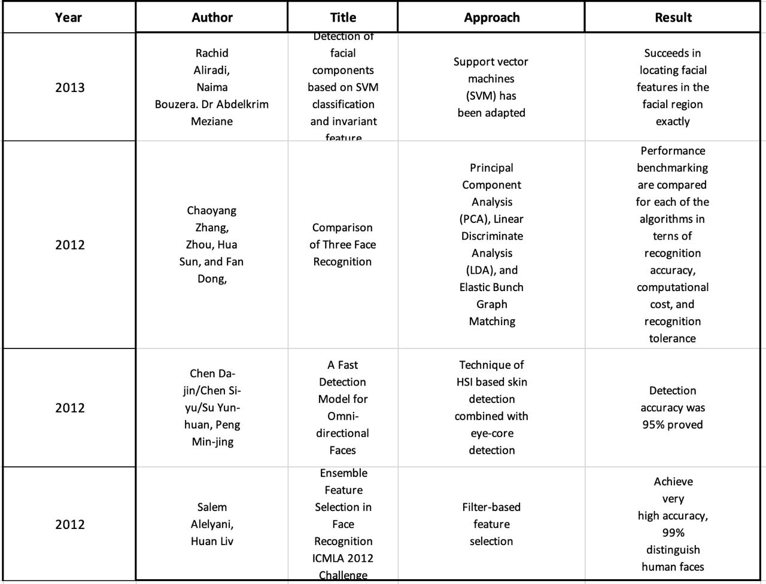
Literature Review

Slide 6
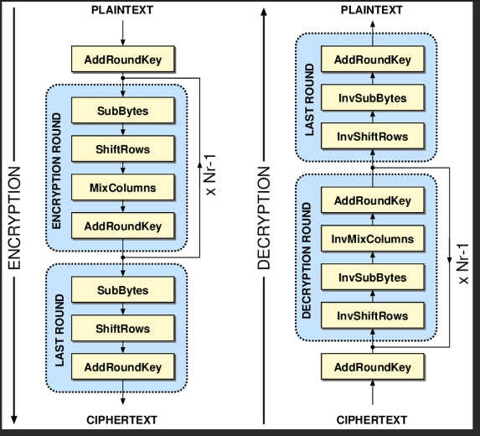
Proposed Methodology/Architecture/Algorithm/Technique/etc
The Advanced Encryption Standard (AES) is a symmetric-key encryption algorithm established as a standard for secure data protection.
AES operates on fixed-size data blocks, typically 128 bits or 16 bytes, and uses a series of substitution and permutation operations for encryption and decryption.
It supports key lengths of 128, 192, and 256 bits, with longer keys providing higher levels of security.
AES is known for its speed and efficiency, making it a popular choice for various applications, including secure communication and data storage.
It has a proven track record of robust security and has become a fundamental encryption method used in many modern cryptographic protocols and systems.

Slide 7

Proposed Methodology/Architecture/Algorithm/Technique/etc

Slide 8
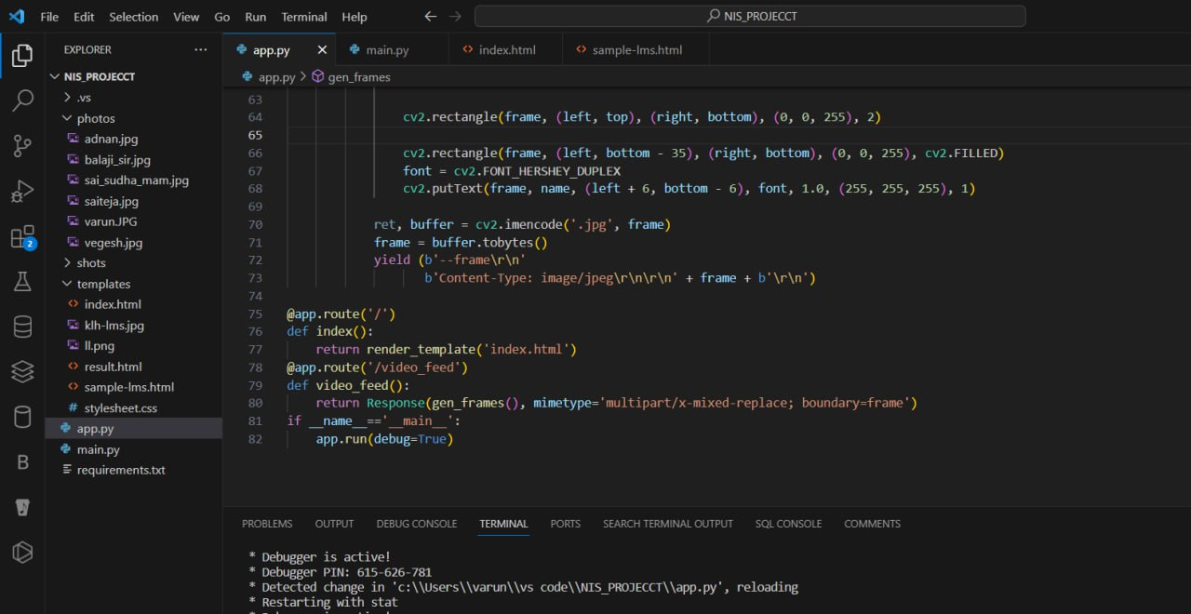
Proposed Methodology/Architecture/Algorithm/Technique/etc

Slide 9
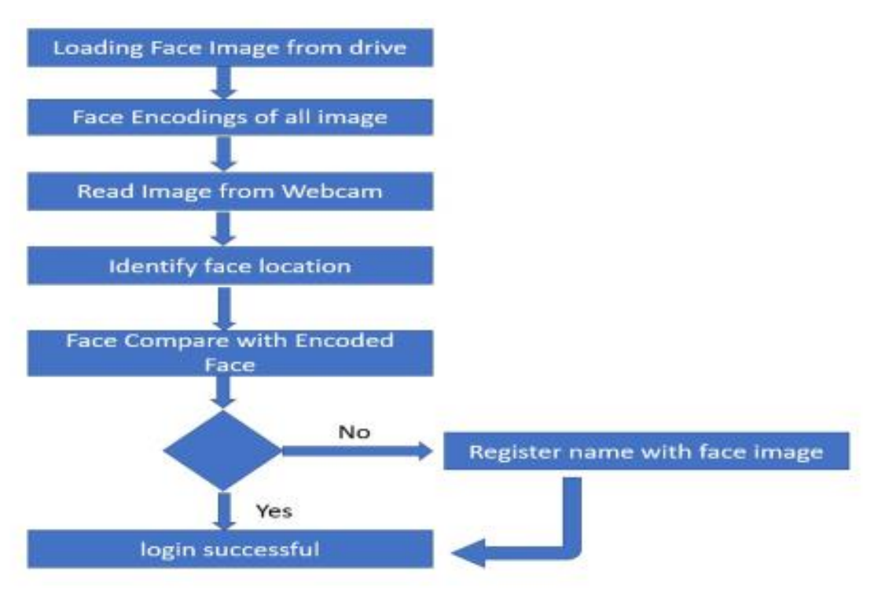
Implementation Details
We are using AES Algorithm for our project.
As AES algorithm consists 4 main
Steps:
• Substitute byte
• Shift row
• Mix columns
• Add round key

Slide 10
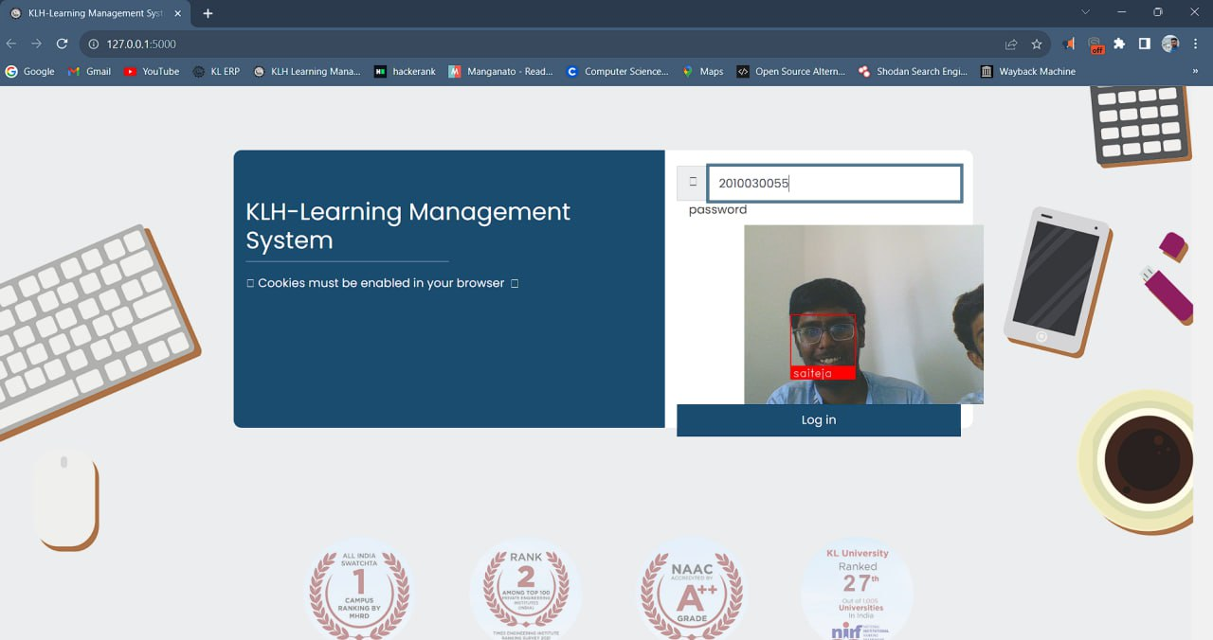
Results/Outputs

Slide 11
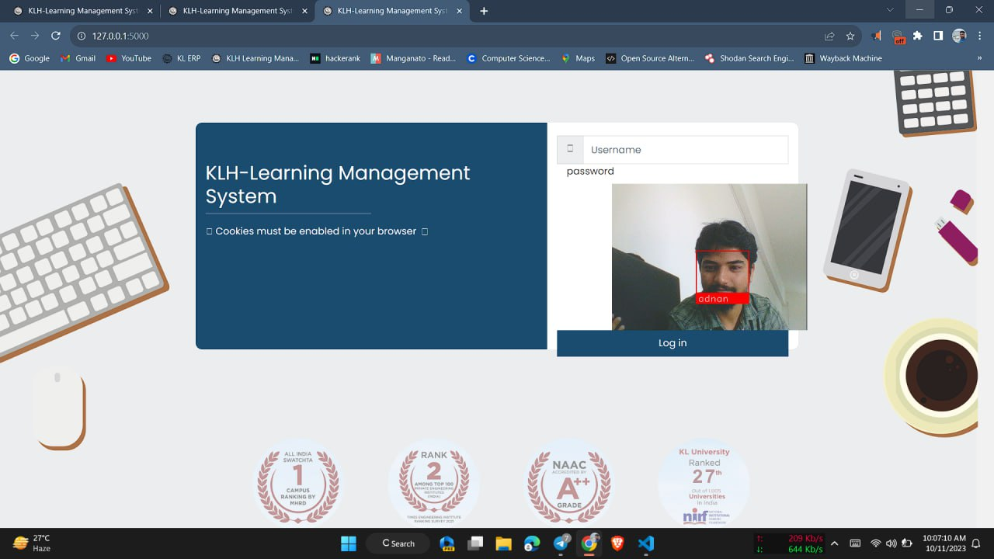
Results

Slide 12
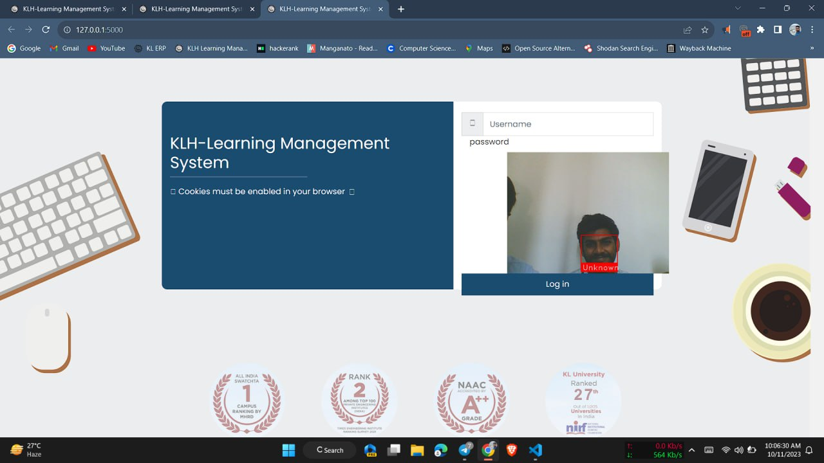
Results

Slide 13
References
https://www.geeksforgeeks.org/advanced-encryption-standard-aes/
https://hackernoon.com/how-to-authenticate-a-user-via-face-recognition-in-your-web-application
(PDF) Face Recognition: A Literature Review (researchgate.net)

Slide 14


